Slide 1
Interrupts and Handlers Bottom halves and deferring work
Dr. Deepamala.N

Slide 2
Interrupts
Communication between slow hardware and relatively very fast processor has to be managed.
Soln 1: polling: Periodically, the kernel can check the status of the hardware in the system and respond accordingly
Disadv: Overhead
Soln 2: Interrupt: provide a mechanism for the hardware to signal to the kernel when attention is needed.This mechanism is called an interrupt.

Slide 3
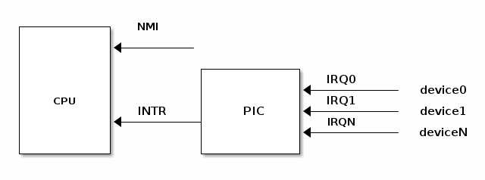
Hardware sends electrical signal to processor (interrupts)
Different devices can be associated with different interrupts by means of a unique value associated with each interrupt. These interrupt values are often called interrupt request (IRQ) lines.
Each IRQ line is assigned a numeric value—for example, on the classic PC, IRQ zero is the timer interrupt and IRQ one is the keyboard interrupt. Interrupts associated with PCI bus are dynamically assigned.
Interrupt controller multiplexes multiple interrupt lines into a single line to the processor
PIC: Programmable Interrupt Controller
Processor process interrupt and inform the OS

Slide 4




Slide 5
Exceptions
Exceptions are synchronous to the processor clock called synchronous interrupts. Eg Divide by zero, page fault etc.
Kernel handles asynchronous interrupts generated by hardware and the synchronous interrupt generated by processor in the similar way.

Slide 6
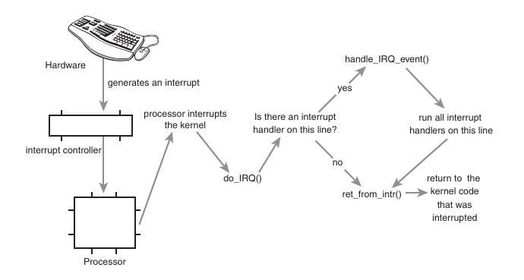
Interrupt Handlers
The function the kernel runs in response to a specific interrupt is called an interrupt handler or interrupt service routine (ISR).
Each device that generates interrupts has an associated interrupt handler
In Linux, interrupt handlers are normal C functions

Slide 7
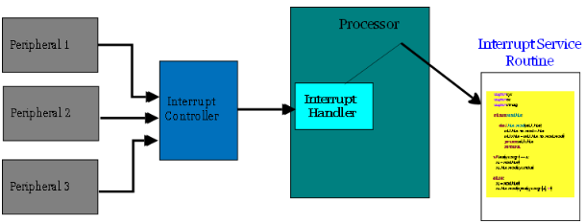
Interrupt handlers
Kernel invokes interrupt handlers in a special context called interrupt context.
This special context is occasionally called atomic context because, as we shall see, code executing in this context is unable to block. In this book, we will use the term interrupt context.
Interrupt handlers acknowledge the hardware and handles the interrupt quickly

Slide 8
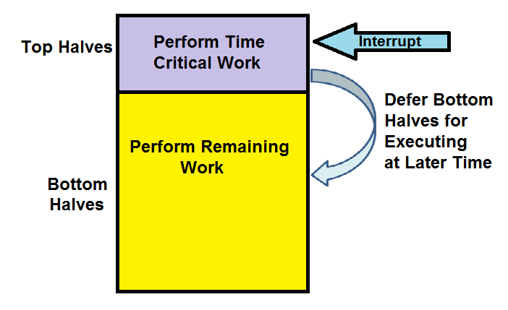
Top Halves and Bottom halves
Processing of interrupts is split into two parts : Top half and Bottom half
Consider Network card receive packet
Issues interrupt
Interrupt runs, acknowledge hardware
Copies packet into memory
These are important, time-critical and hardware specific (think of Gigabit traffic)
If buffers are not cleared, the packets will get dropped
This is Top half
The remaining processing of packet is performed in Bottom half

Slide 9
Registering Interrupt handlers
Drivers managing hardware must register interrupt handlers
/* request_irq: allocate a given interrupt line */
int request_irq(unsigned int irq,
irq_handler_t handler,
unsigned long flags,
const char *name,
void *dev)
Irq: Interrupt number
Handler: function pointer to actual interrupt handler that services the interrupt
Flags: various interrupt handler flags
Name: for /proc/interrupts
Dev: pointer/unique cookie for shared interrupt lines (can be set to NULL is not shared)

Slide 10
Interrupt Handler flags
IRQF_DISABLED—When set, this flag instructs the kernel to disable all interrupts when executing this interrupt handler.
IRQF_SAMPLE_RANDOM—This flag specifies that interrupts generated by this device should contribute to the kernel entropy pool.The kernel entropy pool provides truly random numbers derived from various random events. If this flag is specified, the timing of interrupts from this device are fed to the pool as entropy.
IRQF_TIMER—This flag specifies that this handler processes interrupts for the system timer.
IRQF_SHARED—This flag specifies that the interrupt line can be shared among multiple interrupt handlers. Each handler registered on a given line must specify this flag; otherwise, only one handler can exist per line
Return Value:
On success return zero, nonzero on error. –EBUSY – given interrupt line is busy
Request_irq can sleep, hence cannot be called from interrupt context.
Try commands /proc/interrupts and /proc/stat

Slide 11
ISR Cookie
Use cookies to identify which hardware instance corresponds to which IRQ handler, in case the driver is handling multiple instances of that hardware.
Cookie is usually the return value from kmalloc() (the device private data)
static int ili210x_i2c_probe(struct i2c_client *client, const struct i2c_device_id *id)
{
/* ... */
struct ili210x *priv;
/* ... */
priv = kzalloc(sizeof(*priv), GFP_KERNEL);
/* ... */
error = request_irq(client->irq, ili210x_irq, pdata->irq_flags,
client->name, priv);
}
File: drivers/input/ touchscreen/ili210x.c

Slide 12
While kernel is servicing interrupt, no other useful work is occurring
Also while servicing interrupt, no other interrupts are serviced by that CPU
May miss interrupts, especially when running a real-time system
ISRs must finish quickly
CPU disables preemption just before it jumps into interrupt handling code.
ISRs run in interrupt context, as compared to process context
While running in interrupt context, ISR will not be preempted (on that CPU)
ISR may not call functions that can sleep: kmalloc() with GFP_KERNEL (must instead use GFP_ATOMIC), mutex_lock(), schedule_timeout()
Calling any sleeping function will usually cause a kernel deadlock

Slide 13
Freeing the Interrupt Handler
void free_irq(unsigned int irq, void *dev)
If the specified interrupt line is not shared, this function removes the handler and disables the line. If the interrupt line is shared, the handler identified via dev is removed, but the interrupt line is disabled only when the last handler is removed.
Example:
if (request_irq(irqn, my_interrupt, IRQF_SHARED, "my_device", my_dev)) {
printk(KERN_ERR "my_device: cannot register IRQ %d\n", irqn);
return -EIO;
}
Implementing our own Interrupt Handler
Interrupt Example Program in Linux Kernel ⋆ EmbeTronicX

Slide 14
Writing an Interrupt Handler
The following is a declaration of an interrupt handler:
static irqreturn_t intr_handler(int irq, void *dev)
Irqreturn_t is a special return value
Request_irq returns IRQ_HANDLED if from the device drivers and success
else return IRQ_NONE on failure.

Slide 15
Shared handlers
A shared handler is registered and executed much like a nonshared handler. Following are three main differences:
The IRQF_SHARED flag must be set in the flags argument to request_irq().
The dev argument must be unique to each registered handler.A pointer to any per-device structure is sufficient; a common choice is the device structure as it is both unique and potentially useful to the handler.You cannot pass NULL for a shared handler!
The interrupt handler must be capable of distinguishing whether its device actually generated an interrupt.This requires both hardware support and associated logic in the interrupt handler. If the hardware did not offer this capability, there would be no way for the interrupt handler to know whether its associated device or some other device sharing the line caused the interrupt.

Slide 16
Interrupt Stack
Historically, interrupt handlers did not receive their own stacks. Instead, they would share the stack of the process that they interrupted.
Early in the 2.6 kernel process, an option was added to reduce the stack size from two pages down to one, providing only a 4KB stack on 32-bit systems. This reduced memory pressure because every process on the system previously needed two pages of contiguous, nonswappable kernel memory. To cope with the reduced stack size, interrupt handlers were given their own stack, one stack per processor, one page in size.This stack is referred to as the interrupt stack.

Slide 17
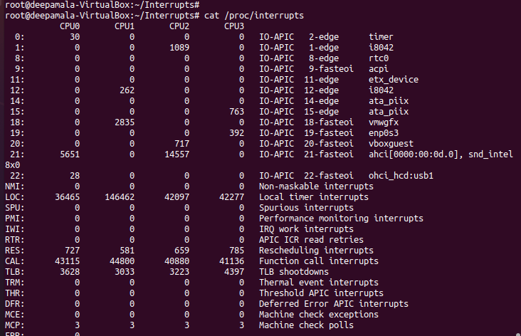
/proc/interrupts
Procfs is a special virtual filesystem that can be mounted in your directory tree, allowing processes in userspace to read kernel information conveniently - using regular file I/O operations (like read and write).
Col1: interrupt line
Col2 : no. of interrupts received (in same CPU for cache locality)
Col3: PIC name
Col 4: device name

Slide 18
Disabling Interrupts
Disable Interrupt at the Interrupt Controller. If you have disabled interrupt at this level, the interrupt wouldn't be passed to internal interrupt controller pipeline. It would not be prioritized, it would not be routed to the destination CPU.
Eg: disable_irq(irq_clk);
Disables all interrupts at the level of CPU IRQ interface.
Eg: local_irq_save(flags);

Slide 19
Interrupt Control
In the 2.6 kernel, you can turn off all interrupt processing on the current processor through any of the following two functions, which are defined in <asm/system.h>
void local_irq_save (unsigned long flags); void local_irq_disable (void);
The local_irq_disable() routine is dangerous if interrupts were already disabled prior to its invocation. The corresponding call to local_irq_enable() unconditionally enables interrupts, despite the fact that they were off to begin with. Instead, a mechanism is needed to restore interrupts to a previous state.
a call to local_irq_save will save the current interrupt status to flags, and then disable interrupt sending on the current processor. Note that flags are passed directly, not pointers. local_irq_disable disables interrupt sending on the local processor without saving state; this version can only be used if we know that the interrupt is not disabled elsewhere.

Slide 20
The interrupt can be opened by the following functions:
void local_irq_restore (unsigned long flags); void local_irq_enable (void);
first version restores the flags state value saved by local_irq_save, and local_irq_enable opens the interrupt unconditionally.
In the 2.6 kernel, there is no way to globally disable all interrupts of the entire system. Kernel developers believe that the cost of turning off all interrupts is too high, so there is no need to provide this capability.

Slide 21
Why store the state?
Flag contains interrupt state from the stack
This is a common concern because a given code path in the kernel can be reached both with and without interrupts enabled, depending on the call chain. For example, imagine the previous code snippet is part of a larger function. Imagine that this function is called by two other functions, one that disables interrupts and one that does not. Because it is becoming harder as the kernel grows in size and complexity to know all the code paths leading up to a function, it is much safer to save the state of the interrupt system before disabling it

Slide 22
Disabling a Specific Interrupt Line
In some cases, it is useful to disable only a specific interrupt line for the entire system. This is called masking out an interrupt line. As an example, you might want to disable delivery of a device’s interrupts before manipulating its state. Linux provides four interfaces for this task:
void disable_irq(unsigned int irq);
void disable_irq_nosync(unsigned int irq);
void enable_irq(unsigned int irq);
void synchronize_irq(unsigned int irq);
The first two functions disable a given interrupt line in the interrupt controller. This disables delivery of the given interrupt to all processors in the system.
Additionally, the disable_irq()function does not return until any currently executing handler completes. Thus, callers are assured not only that new interrupts will not be delivered on the given line, but also that any already executing handlers have exited. The function disable_irq_nosync() does not wait for current handlers to complete.
The function synchronize_irq() waits for a specific interrupt handler to exit, if it is executing, before returning.

Slide 23
It would be rather rude to disable an interrupt line shared among multiple interrupt handlers. Disabling the line disables interrupt delivery for all devices on the line. Therefore, drivers for newer devices tend not to use these interfaces.
Because Peripheral Component Interconnect (PCI) devices have to support interrupt line sharing by specification, they should not use these interfaces at all. Thus, disable_irq() and friends are found more often in drivers for older legacy devices, such as the PC parallel port.

Slide 24
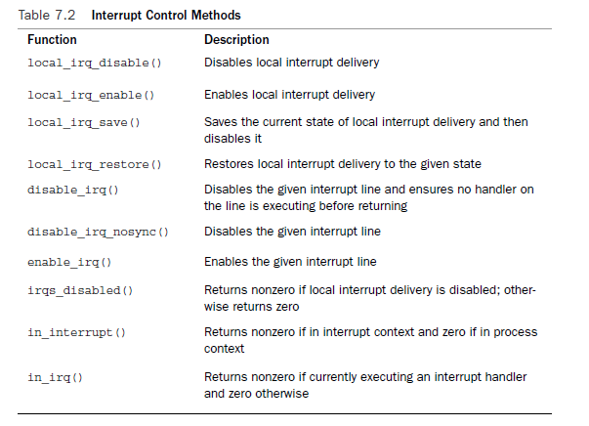
Status of Interrupt system

Slide 25
Are interrupt handlers preemptible?
This depends on both the processor architecture and the kernel architecture.
Generally speaking, interrupt handlers start with interrupts disabled. This is necessary so that the interrupt handler has room for storage — at a minimum, the interrupt handler needs the exclusive use of a few registers, including the program counter, which the processor must save somewhere.
On some processors, it's possible for an interrupt to be interrupted by another higher-priority interrupt. “Interrupt an Interrupt” or nested interrupts.

Slide 26
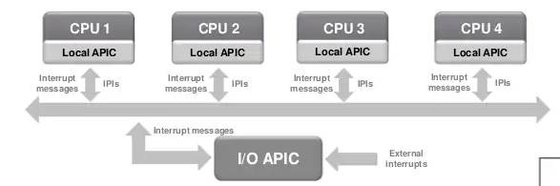
Inter Processor Interrupts
Used to send interrupts between CPUs. Modern multi-core machines need a way for cores to communicate
start/stop/sleep/wakeup other cores
Request task migration
Flushing of low level caches
APIC (Advanced programmable Interrupt controller)

Slide 27
Bottom Halves and Deferring work
Why Bottom halves?
Interrupt handlers run asynchronously and thus interrupt other, potentially important, code, including other interrupt handlers. Therefore, to avoid stalling the interrupted code for too long, interrupt handlers need to run as quickly as possible.
Interrupt handlers run with the current interrupt level disabled at best (if IRQF_DISABLED is unset), and at worst (if IRQF_DISABLED is set – all interrupt lines disabled) with all interrupts on the current processor disabled. As disabling interrupts prevents hardware from communicating with the operating systems, interrupt handlers need to run as quickly as possible.
Interrupt handlers are often timing-critical because they deal with hardware.
Interrupt handlers do not run in process context; therefore, they cannot block. This limits what they can do.

Slide 28
The job of bottom halves is to perform any interrupt-related work not performed by the interrupt handler.
Eg: Top half does 1. Acknowledge hardware, need to copy data to or from hardware as these are time critical work.
Bottom half: Process data copied in top half.
Tips:
If the work is time sensitive, perform it in the interrupt handler.
If the work is related to the hardware, perform it in the interrupt handler.
If the work needs to ensure that another interrupt (particularly the same interrupt) does not interrupt it, perform it in the interrupt handler.
For everything else, consider performing the work in the bottom half.

Slide 29
The Original “Bottom Half”
In the beginning, Linux provided only the “bottom half ” for implementing bottom halves. This name was logical because at the time that was the only means available for deferring work.
It provided a statically created list of 32 bottom halves for the entire system
The top half could mark whether the bottom half would run by setting a bit in a 32-bit integer
Later, Task Queues
Later on, the kernel developers introduced task queues both as a method of deferring work and as a replacement for the BH mechanism
The kernel defined a family of queues. Each queue contained a linked list of functions to call.The queued functions were run at certain times, depending on which queue they were in. Drivers could register their bottom halves in the appropriate queue. This worked fairly well, but it was still too inflexible to replace the BH interface entirely. It also was not lightweight enough for performance critical subsystems, such as networking.

Slide 30
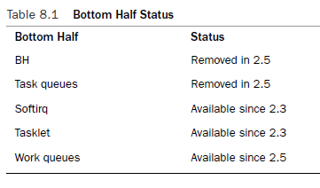

Slide 31
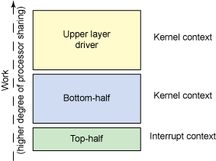
2.3 Kernel onwards: Softirqs and Tasklets
Softirqs are a set of statically defined bottom halves that can run simultaneously on any processor; even two of the same type can run concurrently.
Softirqs are used when performance is critical, such as networking. Two of same softirq can run simultaneously at the same time.
Softirqs must be registered statically at compile time.
Tasklets, which have an awful and confusing name are flexible, dynamically created bottom halves built on top of softirqs.
Two different tasklets can run concurrently on different processors, but two of the same type of tasklet cannot run simultaneously

Slide 32
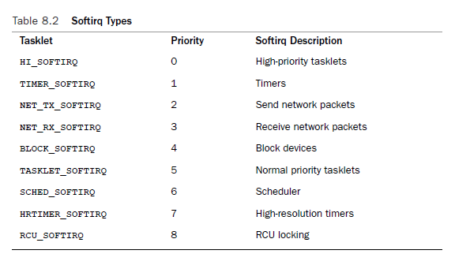

Slide 33
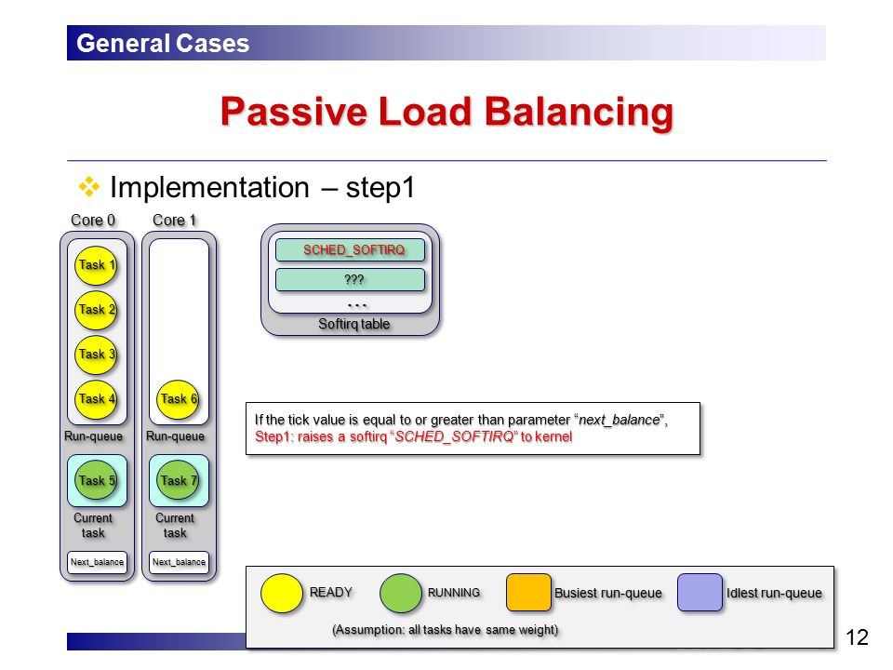
TIMER_SOFTIRQ – Tasklets related to timer interrupts
NET_TX_SOFTIRQ - Feeds packets from network stack to driver
NET_RX_SOFTIRQ – Feeds packets from driver to network stack
RCU_SOFTIRQ – RCU is Read-copy Update which is a lock primitive. It is a synchronization mechanism which was added to the Linux Kernel in October 2002.
HRTIMER_SOFTIRQ - The High Precision Event Timer is a hardware timer used in personal computers. It was developed jointly by Intel and Microsoft and has been incorporated in PC chipsets since 2005, The High Resolution Timers system allows a user space program to be wake up from a timer event with better accuracy

Slide 34
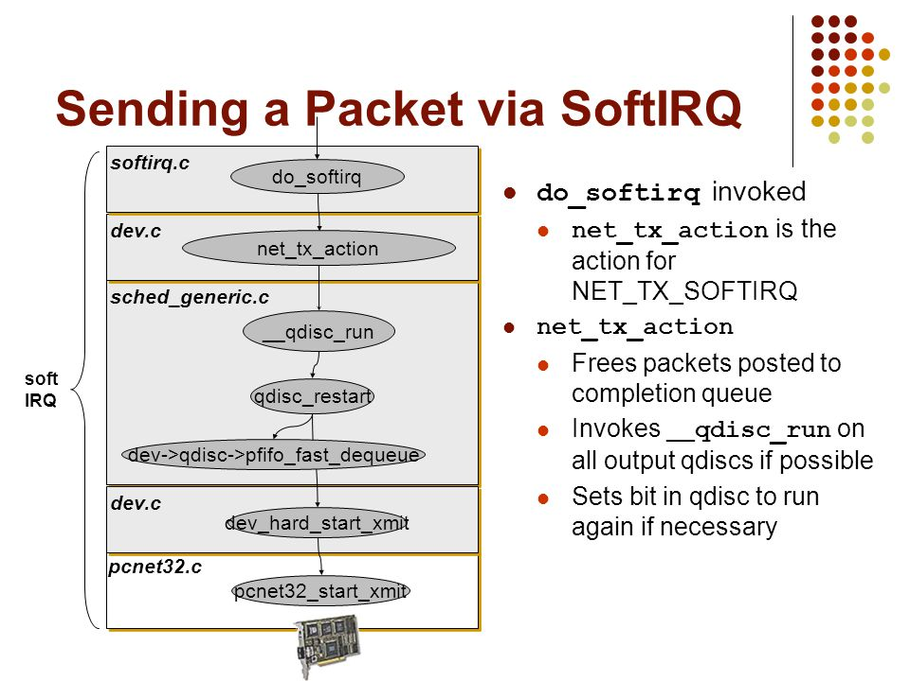
Softirq Implementation
The kernel enforces a limit of 32 registered softirqs; in the current kernel, however, only nine exist.
Softirqs are statically allocated at compile time
softirqs. Softirqs are represented by the softirq_action structure, which is defined in <linux/interrupt.h>
struct softirq_action {
void (*action)(struct softirq_action *);
};
A 32-entry array of this structure is declared in kernel/softirq.c:
static struct softirq_action softirq_vec[NR_SOFTIRQS];

Slide 35
The softirq Handler
Execution
A registered softirq must be marked before it will execute. This is called raising the softirq.
Usually, an interrupt handler marks its softirq for execution before returning.
Pending softirqs are checked for and executed in the following places:
In the return from hardware interrupt code path
In the ksoftirqd kernel thread
In any code that explicitly checks for and executes pending softirqs, such as the networking subsystem
Regardless of the method of invocation, softirq execution occurs in __do_softirq(), which is invoked by do_softirq()
The prototype of a softirq handler, action, looks like
void softirq_handler(struct softirq_action *)
When the kernel runs a softirq handler, it executes this action function with a pointer to the corresponding softirq_action structure as its lone argument.
A softirq never preempts another softirq.
The only event that can preempt a softirq is an interrupt handler
Another softirq—even the same one—can run on another processor, however.

Slide 36
do_softirq
u32 pending;
pending = local_softirq_pending();
if (pending) {
struct softirq_action *h;
/* reset the pending bitmask */
set_softirq_pending(0);
h = softirq_vec;
do {
if (pending & 1)
h->action(h);
h++;
pending >>= 1;
} while (pending);
}
1. It sets the pending local variable to the value returned by the local_softirq_pending() macro. This is a 32-bit mask of pending softirqs—if bit n is set, the nth softirq is pending.
2. Now that the pending bitmask of softirqs is saved, it clears the actual bitmask.
3. The pointer h is set to the first entry in the softirq_vec.
4. If the first bit in pending is set, h->action(h) is called.
5. The pointer h is incremented by one so that it now points to the second entry in the softirq_vec array.
6. The bitmask pending is right-shifted by one. This tosses the first bit away and moves all other bits one place to the right. Consequently, the second bit is now the first (and so on).
7. The pointer h now points to the second entry in the array, and the pending bitmask now has the second bit as the first. Repeat the previous steps.
8. Continue repeating until pending is zero, at which point there are no more pending softirqs and the work is done. Note, this check is sufficient to ensure always points to a valid entry in softirq_vec because pending has at most 32 set bits and thus this loop executes at most 32 times.

Slide 37
Softirqs
Softirqs are for timing critical bottom half processing like networking and block devices.
Kernel timers and tasklets are built on softirqs
Softirqs are added in compile time and tasklets can be dynamically added.
Observe priority in the softirq table
Softirq with lowest priority runs before the higher one

Slide 38
Top half registering softirq
Softirq handler is registered at run-time via open_softirq()
open_softirq(NET_TX_SOFTIRQ, net_tx_action);
open_softirq(NET_RX_SOFTIRQ, net_rx_action);
The softirq handlers run with interrupts enabled and cannot sleep
Other softirqs are disabled in current CPU, other CPU can run same or other softirqs
Proper locking required as it is a reentrant code but since CPUs have per-processor data locking may not be required all the time. It leads to scalability (high speed)
If scalability is not a critieria go for tasklets. Same tasklet cannot run on multiple processors simultaneously.

Slide 39
How to raise softirq?
raise_softirq()
Eg: raise_softirq(NET_TX_SOFTIRQ);

Slide 40
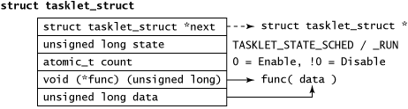
Tasklets
Tasklets are a bottom-half mechanism built on top of softirqs
they have a simpler interface and relaxed locking rules (as same tasklet cannot run simultaneously)
Implementing Tasklets – Tasklet structure
struct tasklet_struct {
struct tasklet_struct *next; /* next tasklet in the list */
unsigned long state; /* state of the tasklet */
atomic_t count; /* reference counter */
void (*func)(unsigned long); /* tasklet handler function */
unsigned long data; /* argument to the tasklet function */
};

Slide 41
The func member is the tasklet handler (the equivalent of action to a softirq) and receives data as its sole argument.
The state member is exactly zero, TASKLET_STATE_SCHED, or TASKLET_STATE_RUN.
TASKLET_STATE_SCHED denotes a tasklet that is scheduled to run, and TASKLET_STATE_RUN denotes a tasklet that is running. As an optimization, TASKLET_STATE_RUN is used only on multiprocessor machines because a uniprocessor machine always knows whether the tasklet is running.
The count field is used as a reference count for the tasklet. If it is nonzero, the tasklet is disabled and cannot run; if it is zero, the tasklet is enabled and can run if marked pending.
Scheduling Tasklets
Tasklets are stored in two per-processor structures:
tasklet_vec (for regular tasklets) and tasklet_hi_vec (for high-priority tasklets).
Both of these structures are linked lists of tasklet_struct structures. Each tasklet_struct structure in the list represents a different tasklet.
Tasklets are scheduled via the tasklet_schedule() and tasklet_hi_schedule() functions, which receive a pointer to the tasklet’s tasklet_struct as their lone argument. Each function ensures that the provided tasklet is not yet scheduled and then calls __tasklet_schedule() and __tasklet_hi_schedule() as appropriate.The two functions are similar. (The difference is that one uses TASKLET_SOFTIRQ and one uses HI_SOFTIRQ.)

Slide 42
Tasklet_Schedule
1. Check whether the tasklet’s state is TASKLET_STATE_SCHED. If it is, the tasklet is
already scheduled to run and the function can immediately return.
2. Call __tasklet_schedule().
3. Save the state of the interrupt system, and then disable local interrupts.This ensures that nothing on this processor will mess with the tasklet code while tasklet_schedule() is manipulating the tasklets.
4. Add the tasklet to be scheduled to the head of the tasklet_vec or tasklet_hi_vec linked list, which is unique to each processor in the system.
5. Raise the TASKLET_SOFTIRQ or HI_SOFTIRQ softirq, so do_softirq() executes this
tasklet in the near future.
6. Restore interrupts to their previous state and return.

Slide 43
do_softirq() -> tasklet_action() and tasklet_hi_action()
Disable local interrupt delivery (there is no need to first save their state because the code here is always called as a softirq handler and interrupts are always enabled) and retrieve the tasklet_vec or tasklet_hi_vec list for this processor.
Clear the list for this processor by setting it equal to NULL.
Enable local interrupt delivery.Again, there is no need to restore them to their previous state because this function knows that they were always originally enabled.
Loop over each pending tasklet in the retrieved list.
If this is a multiprocessing machine, check whether the tasklet is running on another processor by checking the TASKLET_STATE_RUN flag. If it is currently running, do not execute it now and skip to the next pending tasklet
If the tasklet is not currently running, set the TASKLET_STATE_RUN flag, so another processor will not run it.
Check for a zero count value, to ensure that the tasklet is not disabled. If the tasklet is disabled, skip it and go to the next pending tasklet
We now know that the tasklet is not running elsewhere, is marked as running so it will not start running elsewhere, and has a zero count value. Run the tasklet handler.
After the tasklet runs, clear the TASKLET_STATE_RUN flag in the tasklet’s state field.
Repeat for the next pending tasklet, until there are no more scheduled tasklets waiting to run

Slide 44
How to declare tasklet?
DECLARE_TASKLET(name, func, data)
DECLARE_TASKLET_DISABLED(name, func, data);
Writing Your Tasklet Handler
The tasklet handler must match the correct prototype:
void tasklet_handler(unsigned long data)
As with softirqs, tasklets cannot sleep.This means you cannot use semaphores or other blocking functions in a tasklet

Slide 45
ksoftirqd
Softirq (and thus tasklet) processing is aided by a set of per-processor kernel threads

Slide 46
Workqueues
Work queues defer work into a kernel thread—this bottom half always runs in process context. (disk, sound, network)
work queues are schedulable and can therefore sleep.
it is easy to decide between using work queues and softirqs/tasklets. If the deferred work needs to sleep, work queues are used.
Similar to kernel threads, but work queues are easy to use.
useful for situations in which you need to allocate a lot of memory, obtain a semaphore, or perform block I/O.

Slide 47
Implementing workqueues
Used terms
Work item(work) – simple struct, pointer to a to-run function
Delayed work(dwork) – more complex work, timer+normal work
Worker thread – special threads that processes work items 1 by one
Worker pool – pool of worker thread with same CPU affinity and process priority
Workqueue – virtual FIFO queue

Slide 48
Default worker threads
The default worker threads are called events/n where n is the processor number; there is one per processor.
The default worker thread handles deferred work from multiple locations. Many drivers in the kernel defer their bottom-half work to the default thread. Unless a driver or subsystem has a strong requirement for creating its own thread, the default thread is preferred.

Slide 49
Important data structures
cpu_workqueue_struct structure.
The structure binds the CPU to the kernel thread. In the process of creating a workflow, Linux creates a cpu_workqueue_struct based on the number of CPUs in the current system.
struct cpu_workqueue_struct {
spinlock_t lock; /* lock protecting this structure */
struct list_head worklist; /* list of work */
wait_queue_head_t more_work;
struct work_struct *current_struct;
struct workqueue_struct *wq; /* associated workqueue_struct */
task_t *thread; /* associated thread */
};

Slide 50
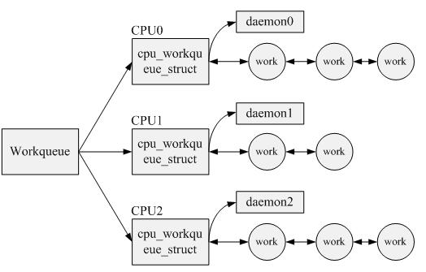
Structure onto which work is placed.
struct workqueue_struct {
struct cpu_workqueue_struct cpu_wq[NR_CPUS];
struct list_head list;
const char *name;
int singlethread;
int freezeable;
int rt;
};

Slide 51
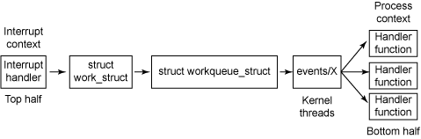
Work is represented by work_struct structure
<linux/workqueue.h>:
struct work_struct {
atomic_long_t data;
struct list_head entry;
work_func_t func;
};
The events/X kernel threads (one per CPU) extract work from the work queue and activates one of the bottom-half handlers (func member)

Slide 52
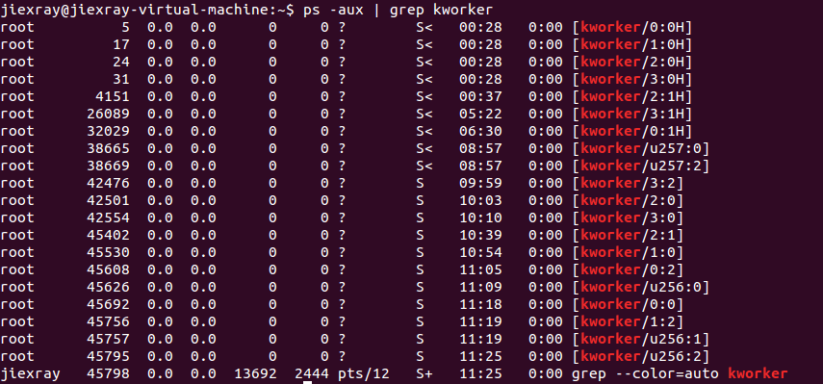
Worker threads

Slide 53
Let’s look at the heart of worker_thread(), simplified:
for (;;) {
prepare_to_wait(&cwq->more_work, &wait, TASK_INTERRUPTIBLE);
if (list_empty(&cwq->worklist))
schedule();
finish_wait(&cwq->more_work, &wait);
run_workqueue(cwq);
}
This function performs the following functions, in an infinite loop:
1. The thread marks itself sleeping (the task’s state is set to TASK_INTERRUPTIBLE) and
adds itself to a wait queue.
2. If the linked list of work is empty, the thread calls schedule() and goes to sleep.
3. If the list is not empty, the thread does not go to sleep. Instead, it marks itself
TASK_RUNNING and removes itself from the wait queue.
4. If the list is nonempty, the thread calls run_workqueue() to perform the deferred
work.

Slide 54
The function run_workqueue(), in turn, actually performs the deferred work:
while (!list_empty(&cwq->worklist)) {
struct work_struct *work;
work_func_t f;
void *data;
work = list_entry(cwq->worklist.next, struct work_struct, entry);
f = work->func;
list_del_init(cwq->worklist.next);
work_clear_pending(work);
f(work);
}
This function loops over each entry in the linked list of pending work and executes
the func member of the workqueue_struct for each entry in the linked list:
1. While the list is not empty, it grabs the next entry in the list.
2. It retrieves the function that should be called, func, and its argument, data.
3. It removes this entry from the list and clears the pending bit in the structure itself
4. It invokes the function.
5. Repeat.

Slide 55
Using work queues
Using default events queue
Creating work:
The first step is actually creating some work to defer.To create the structure statically at runtime, use DECLARE_WORK:
DECLARE_WORK(name, void (*func)(void *), void *data);
Alternatively, you can create work at runtime via a pointer:
INIT_WORK(struct work_struct *work, void (*func)(void *), void *data);
This dynamically initializes the work queue pointed to by work with handler function func and argument data.

Slide 56
Workqueue handler
The prototype for the work queue handler is
void work_handler(void *data)
A worker thread executes this function, and thus, the function runs in process context.
By default, interrupts are enabled and no locks are held. If needed, the function can sleep.
Note that, despite running in process context, the work handlers cannot access user-space memory because there is no associated user-space memory map for kernel threads.

Slide 57
Scheduling work
To queue a given work’s handler function with the default events worker threads, simply call
schedule_work(&work);
Sometimes you do not want the work to execute immediately, but instead after some delay. In those cases, you can schedule work to execute at a given time in the future:
schedule_delayed_work(&work, delay);

Slide 58
To flush workqueue (eg: unloading)
void flush_scheduled_work(void);
This function waits until all entries in the queue are executed before returning. While waiting for any pending work to execute, the function sleeps. Therefore, you can call it only from process context.
To cancel delayed work, call
int cancel_delayed_work(struct work_struct *work);

Slide 59
Creating new workqueues
If the default queue is insufficient for your needs, you can create a new work queue and corresponding worker threads.
struct workqueue_struct *create_workqueue(const char *name);
following functions are analogous to schedule_work() and schedule_delayed_work(), except that they work on the given work queue and not the default events queue.
int queue_work(struct workqueue_struct *wq, struct work_struct *work)
int queue_delayed_work(struct workqueue_struct *wq,
struct work_struct *work, unsigned long delay)

Slide 60
Which bottomhalf should I use?
Softirqs – same type can run simultaneously on multiple CPUs. If code in question is highly threaded like networking, softirq is best, They are certainly the fastest alternative for timing critical and high-frequency uses
Tasklets are easier to implement (no concurrency), device drivers usually prefer tasklet unless its time critical
If your work need to run in process context, your only choice is workqueue. Can sleep. Highest overhead due to kernel threads and context switching. Most preferred.

Slide 61
Locking Between the Bottom Halves
The same tasklet will not run concurrently, even on two different processors. This means you do not have to worry about intra-tasklet concurrency issues.
Because softirqs provide no serialization, (even two instances of the same softirq might run simultaneously), all shared data needs an appropriate lock.
If process context code and a bottom half share data, you need to disable bottom-half processing and obtain a lock before accessing the data.
If interrupt context code and a bottom half share data, you need to disable interrupts and obtain a lock before accessing the data.
Any shared data in a work queue requires locking, too.

Slide 62
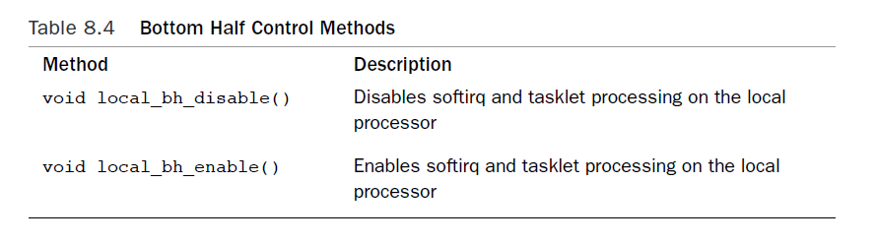

Slide 63
Extra reading

Slide 64
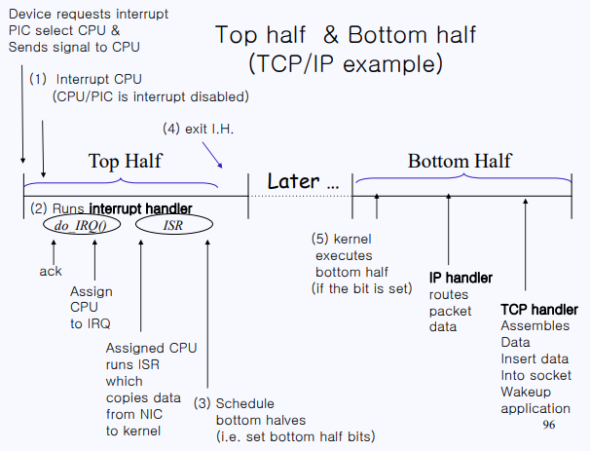

Slide 65
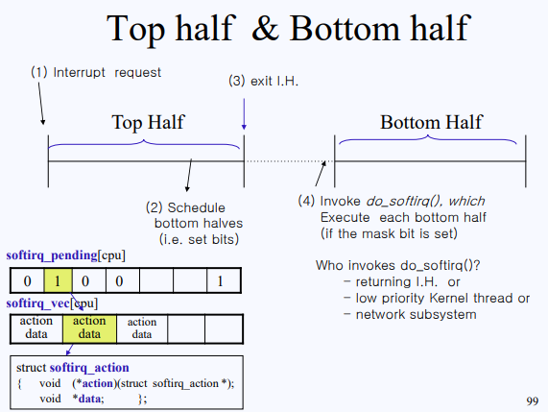

Slide 66
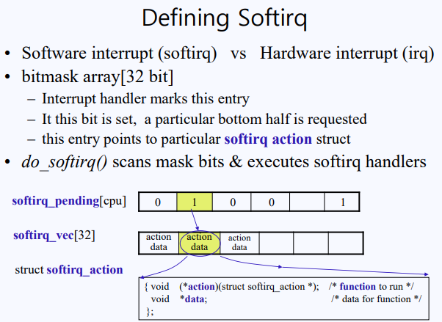

Slide 67
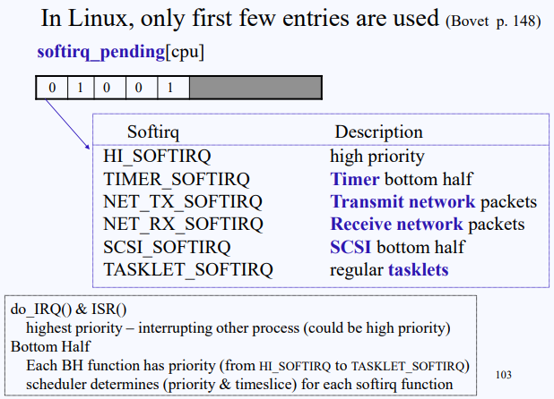

Slide 68
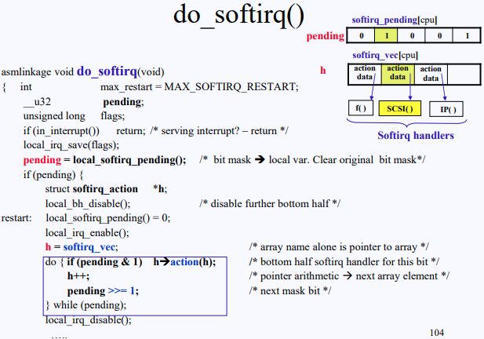

Slide 69
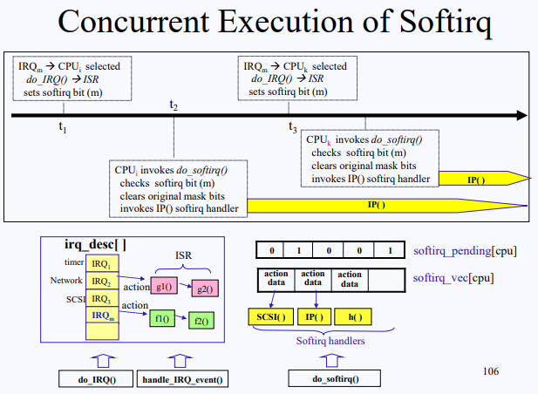

Slide 70
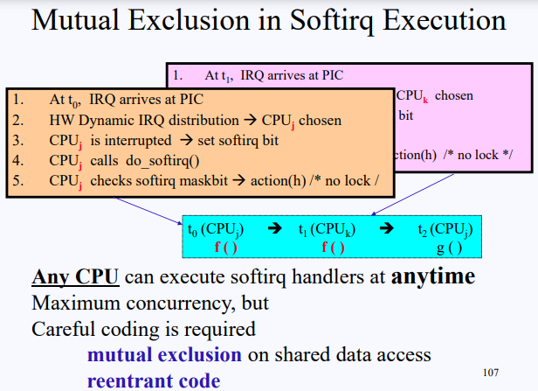

Slide 71
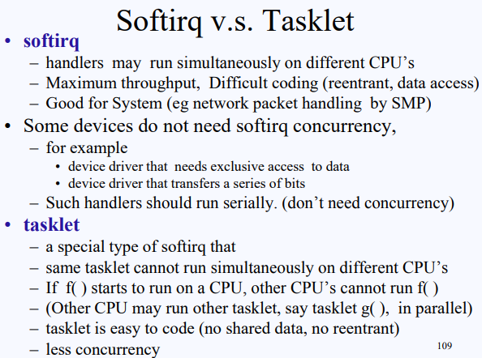

Slide 72
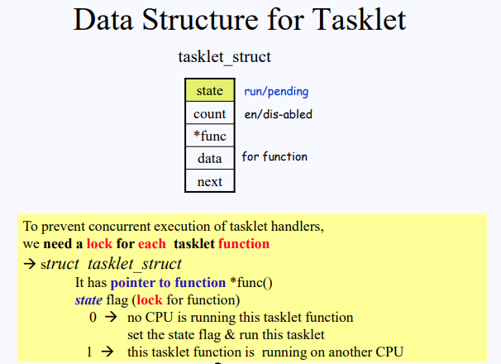

Slide 73
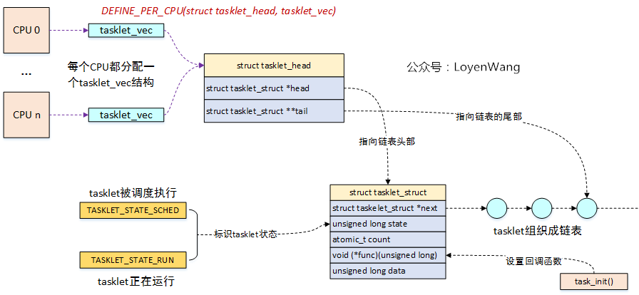

Slide 74
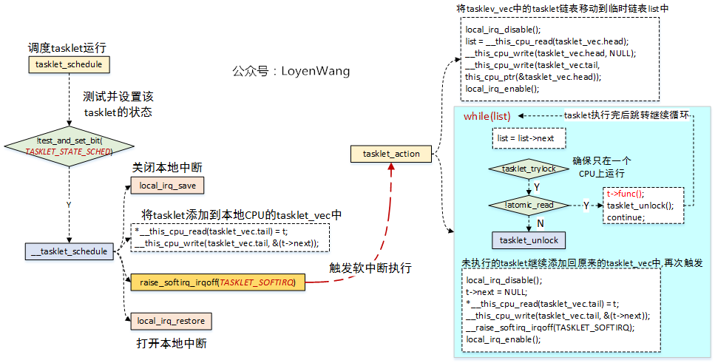

Slide 75
DECLARE_TASKLET(name, func, data)
void tasklet_init(struct tasklet_struct *t, void (*func)(unsigned long), unsigned long data);
void tasklet_disable(struct tasklet_struct *t);
void tasklet_enable(struct tasklet_struct *t);
void tasklet_schedule(struct tasklet_struct *t);
void tasklet_kill(struct tasklet_struct *t)；

